Slide 1

C# CODE STRUCTURE
.NET

Slide 2
Don’t start jumping into design, creating folders as they come, adding features when you think about it. Sit down for a minute, think clearly about what resources you will need, which technologies or languages you will use, and how to structure all this.
- Julien rio

Slide 3
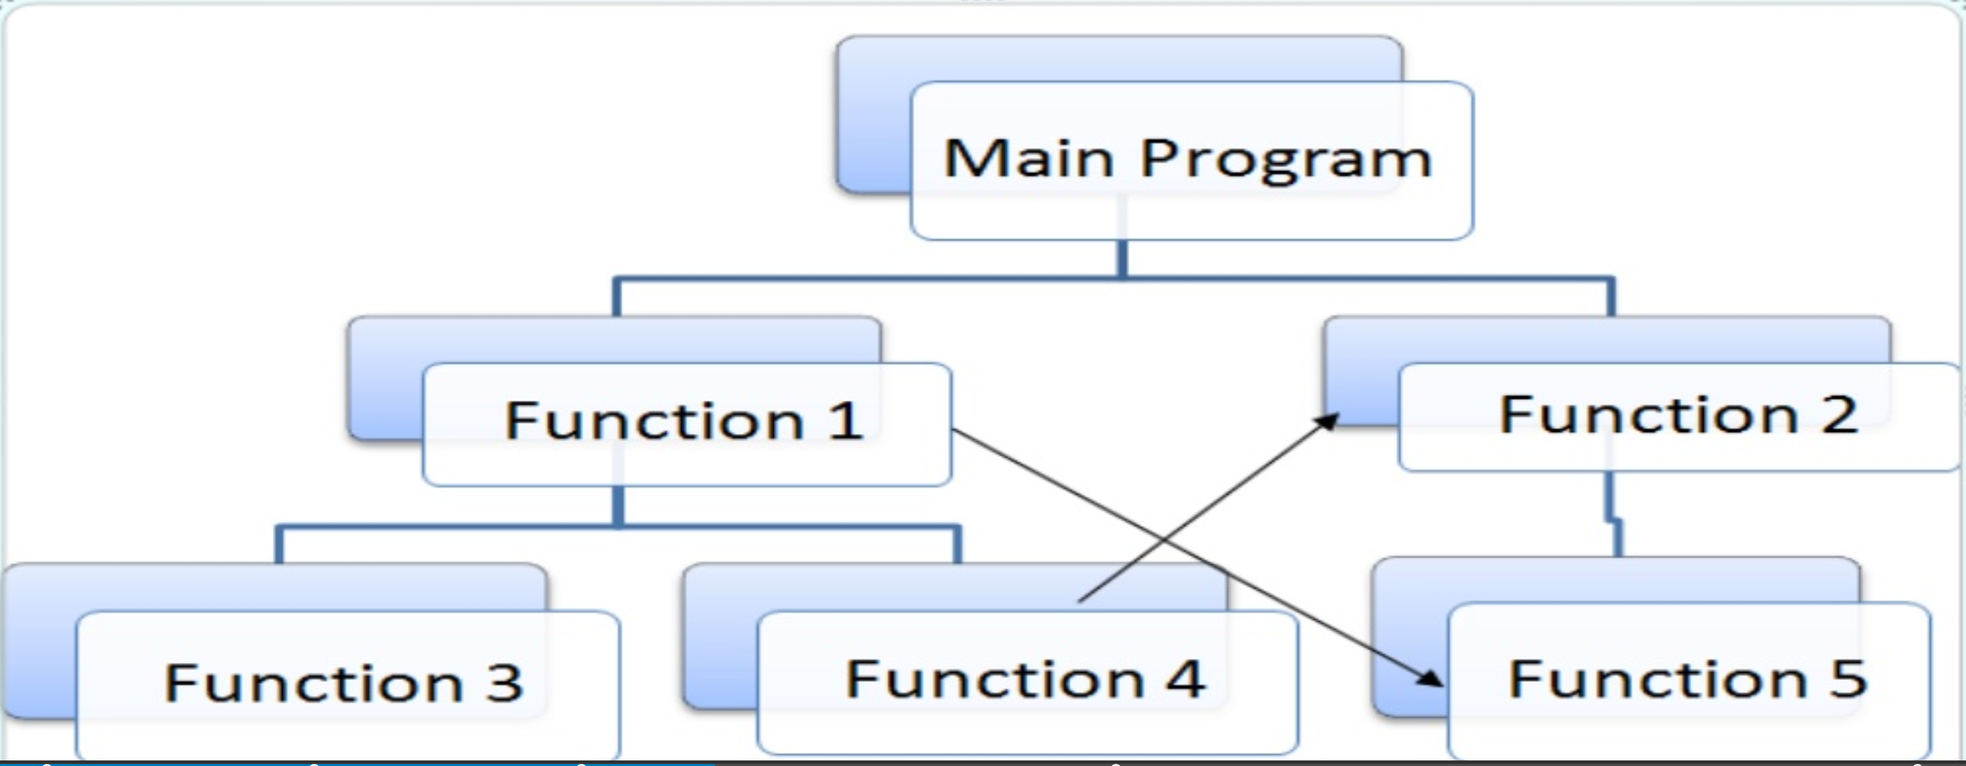
Procedural Programming https://en.wikipedia.org/wiki/Procedural_programming
Procedural programming is a programming methodology derived from ‘structured’ programming. It’s based on the concept of the procedure call.
Procedures (routines, subroutines, functions, methods) contain a series of computational steps to be carried out.
A method can be called at any point during a program's execution by other methods or by itself (recursion).

Slide 4
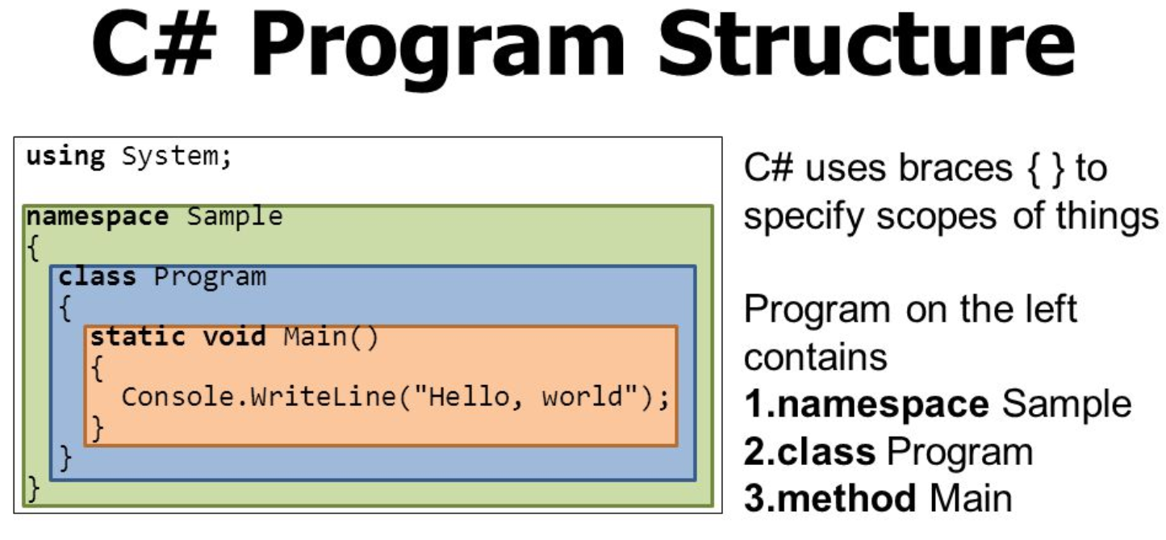
C# Program Structure https://docs.microsoft.com/en-us/dotnet/csharp/tour-of-csharp/program-structure
The key organizational concepts in C# are programs, namespaces, types, members, and assemblies. C# programs consist of one or more source files.
Programs declare namespaces.
Namespaces contain types (classes/interfaces).
Types contain members (fields, methods, Properties, events)
When C# programs are compiled, they're packaged into assemblies with file extensions .exe (Executable) or .dll (Dynamic Link Library).

Slide 5
Your first .NET program https://docs.microsoft.com/en-us/dotnet/csharp/tour-of-csharp/#hello-world
Hello World
To create this program, first download and install the .NET Core SDK.
Open the command line interface. I use Gitbash.
Then, create a new program in a file named hello with:
dotnet new console -o hello --use-program-main
-o tells the SDk to name the program hello. You can put whatever name you want here.
--use-program-main will tell the .NET Software Development Kit (SDK) to include some top-level syntax that would normally be abstracted.
The program documentation is in the file hello.csproj.
In the command line, type cd hello.
Build and run the application with the run command: dotnet run

Slide 6
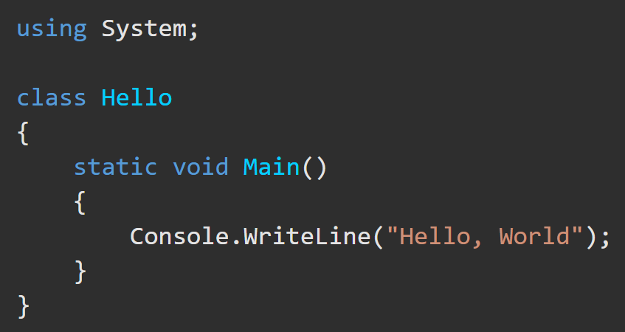
Hello, World in C# https://docs.microsoft.com/en-us/dotnet/csharp/tour-of-csharp/#hello-world
Hello, World starts with a using directive to include the System namespace.
“using System” allows the program to use Console.WriteLine as shorthand for System.Console.WriteLine.
System namespace is provided by the Base Class Library.
System contains the Console class, I/O functionality, Collections, and other useful classes.
Namespaces provide a hierarchical means of organizing C# programs and libraries. Namespaces contain types and other namespaces.
A static method named Main serves as the entry point of any .NET program.

Slide 7
C# Program Structure https://docs.microsoft.com/en-us/dotnet/csharp/tour-of-csharp/program-structure
using System;
using System.Collections.Generic;
using System.Linq;
using System.Text;
using System.Threading.Tasks;
namespace MyFirstProgram
{
class Program
{
static void Main(string[] args)
{
string howdy = “Hello World!”;
Console.WriteLine($“{howdy} \tthere \npardn’r!”);
}
}
}
Namespace. A logical grouping of classes.
References to .NET Namespaces.
Class. An object and scope for logically related functionality.
static void Main Method The entrypoint to a C# program.
Data type and variable name.
A value that the data type holds.
WriteLine() takes an arg to write to the console.

Slide 8
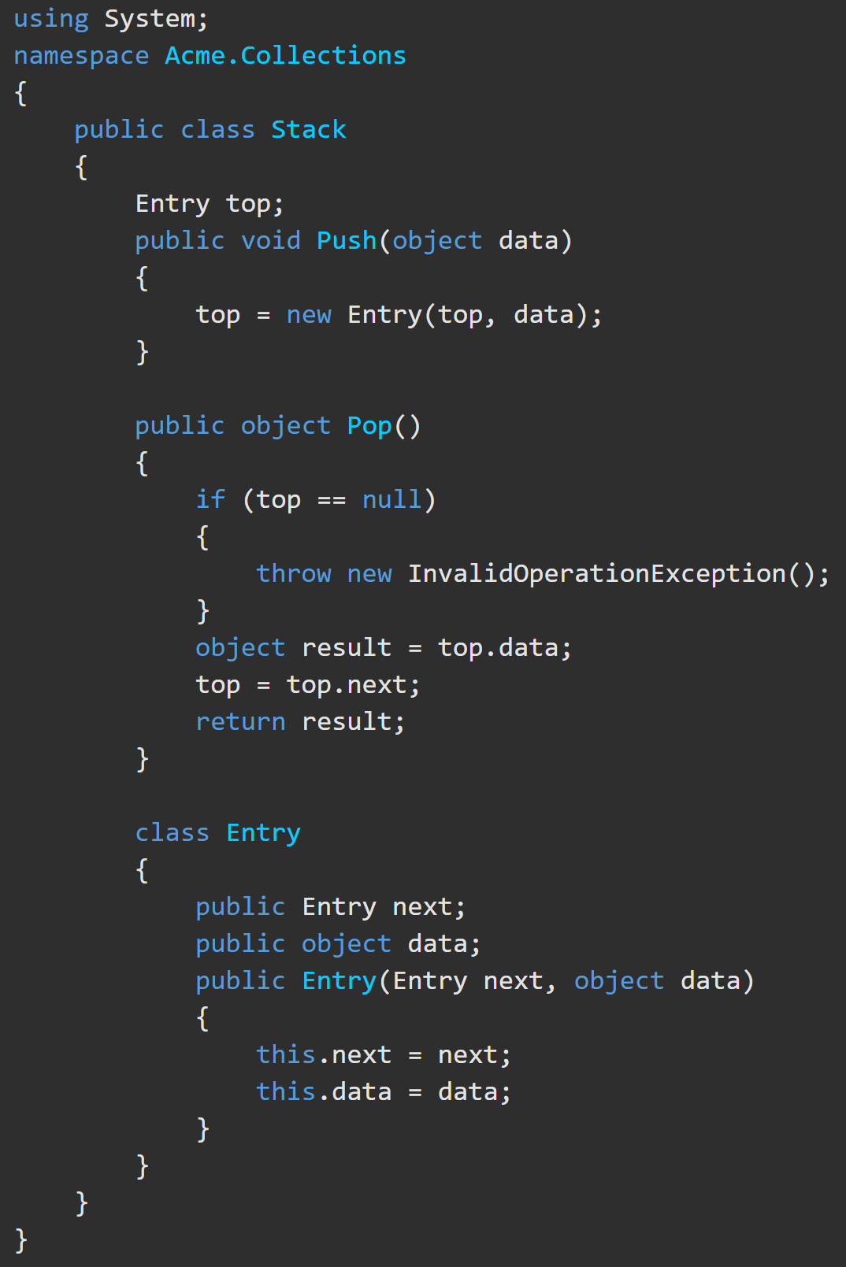
Classes https://docs.microsoft.com/en-us/dotnet/csharp/tour-of-csharp/program-structure
The fully qualified name of this class is Acme.Collections.Stack.
Class Stack contains several members:
The Entry class contains three members
A field: top | Two methods: Push Pop | A nested class: Entry.
Two fields: next data | A parameterized constructor

Slide 9
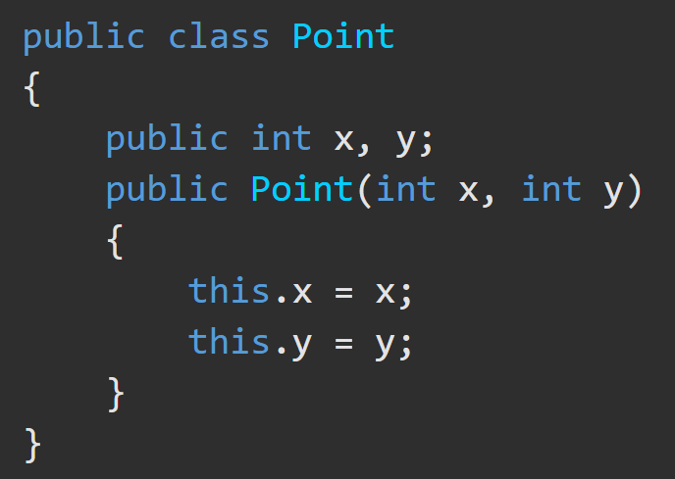
Classes https://docs.microsoft.com/en-us/dotnet/csharp/tour-of-csharp/classes-and-objects
Classes are the most fundamental of C#’s types.
A class is a data structure that combines state (fields) and actions (methods) into a single unit.
A class provides a template for instances of the class, known as objects.
New classes are created using class declarations.
Point myPoint = new Point(1,2);

Slide 10
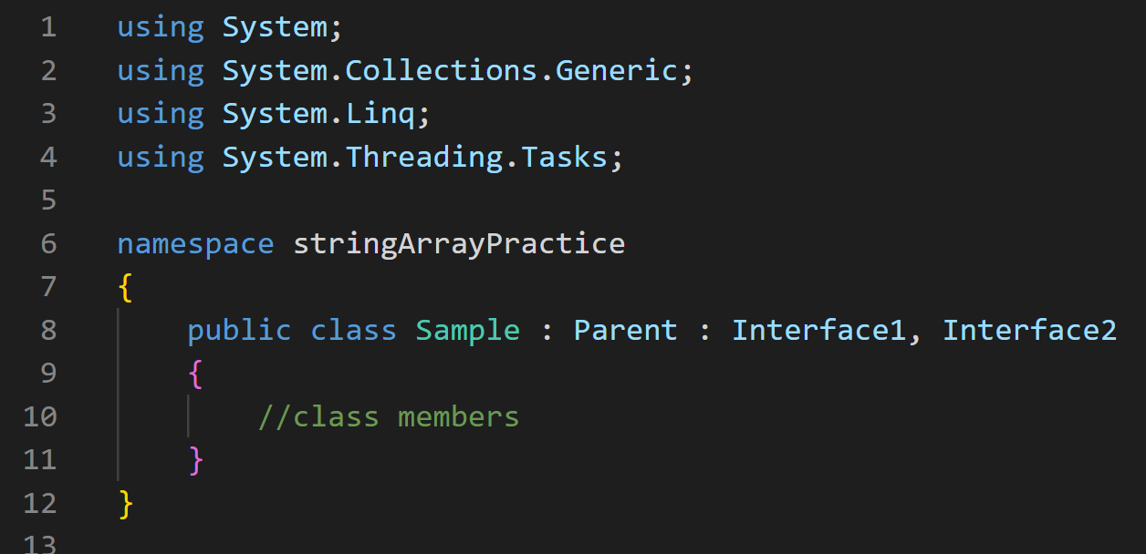
Classes https://learn.microsoft.com/en-us/dotnet/csharp/language-reference/language-specification/classes#152-class-declarations
A class declaration starts with a header that specifies:
the attributes and modifiers of the class,
the name of the class,
(optional) the base class, and
(optional) the interfaces implemented by the class.
The declaration header is followed by the class body, which consists of a list of member declarations written between the scope delimiters { and }.

Slide 11
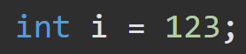
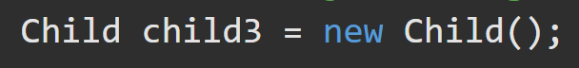
Data Types https://docs.microsoft.com/en-us/dotnet/csharp/tour-of-csharp/types-and-variables
C# supports two kinds of variable types:
Value types | Reference types
These are built-in data types, such as char, int, boolean, and float. One user-defined type, struct, is a value type. Value types directly contain their data on the stack. | Complex data types like classes are constructed from the built-in types. These types contain a reference to a location in heap memory where the data is directly held.

Slide 12
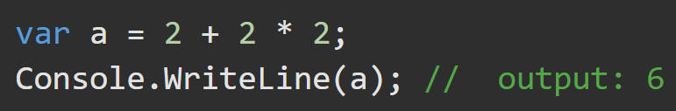
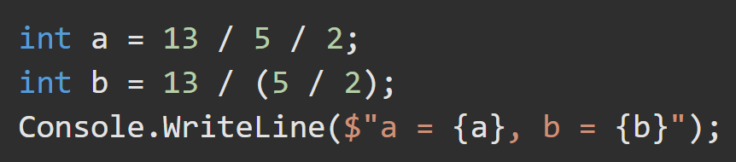
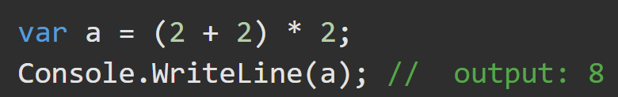
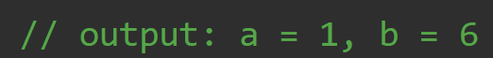
Expressions https://docs.microsoft.com/en-us/dotnet/csharp/tour-of-csharp/expressions https://docs.microsoft.com/en-us/dotnet/csharp/language-reference/operators/
Expressions are constructed from operands and operators.
Operators are: +, -, *, /, and new.
Operands are literals, fields, local variables, expressions. They are acted upon by the operators.
Precedence of the operators controls the order in which the individual operators are evaluated. (Basically PEMDAS).

Slide 13
Statements https://docs.microsoft.com/en-us/dotnet/csharp/tour-of-csharp/statements
The actions of any program are expressed using statements. C# uses various statement types.
A block consists of a list of statements written between the delimiters { }.
Declaration is used to create variables and constants.
Expression statements are used to evaluate actions taken on values.
Selection statements are used for “flow control”.
Iteration statements include the while, do, for, and foreach statements. They repeat until a predetermined condition is met.
Jump statements are used to transfer control. This group contains the break, continue, goto, throw, return, and yield statements.

Slide 14
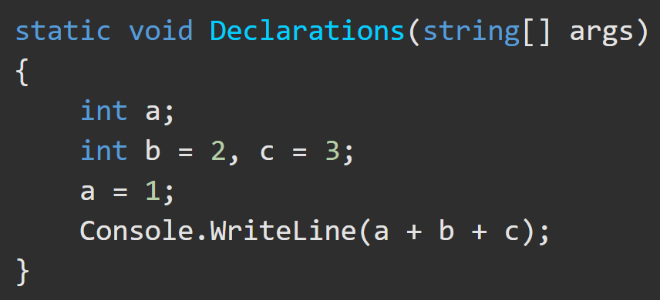
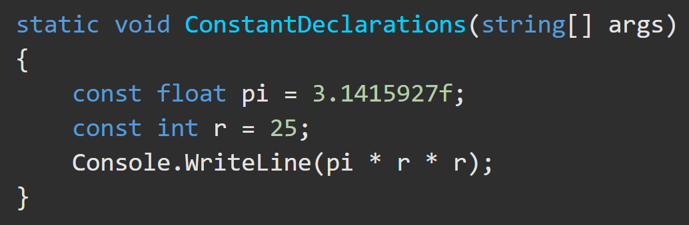
Block and Declaration Statements https://docs.microsoft.com/en-us/dotnet/csharp/tour-of-csharp/statements
A block permits multiple statements to be written in contexts where a single statement is allowed. A block consists of a list of statements written between the delimiters { }.
Declaration statements are used to declare local variables and constants.
Local Variable Declaration Local Constant Declaration

Slide 15
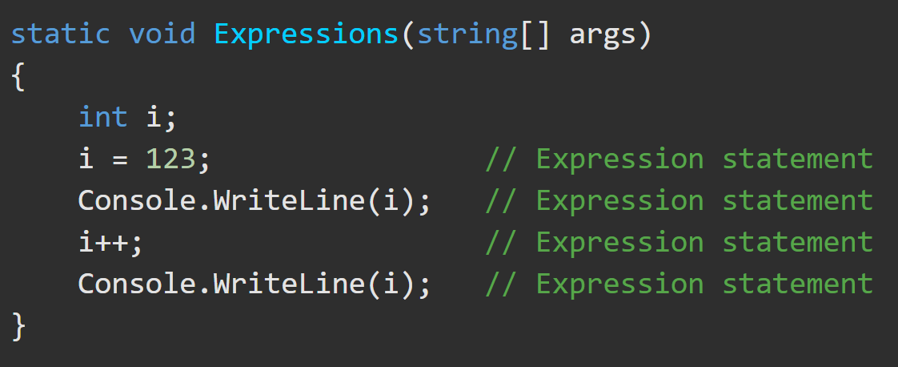
Expression Statements https://docs.microsoft.com/en-us/dotnet/csharp/tour-of-csharp/statements
Expression statements are used to evaluate expressions. Examples of expression statements are:
method invocations,
object allocations using the new operator,
assignments using =,
compound assignment operators,
increment (++) and decrement (--) operations
and async/await expressions.

Slide 16
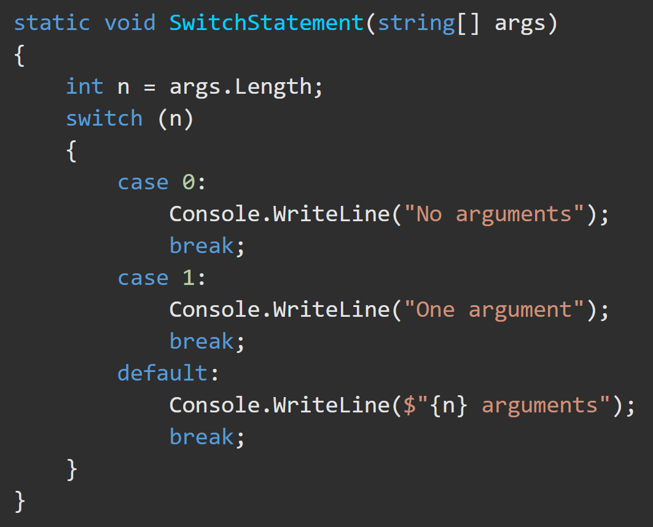
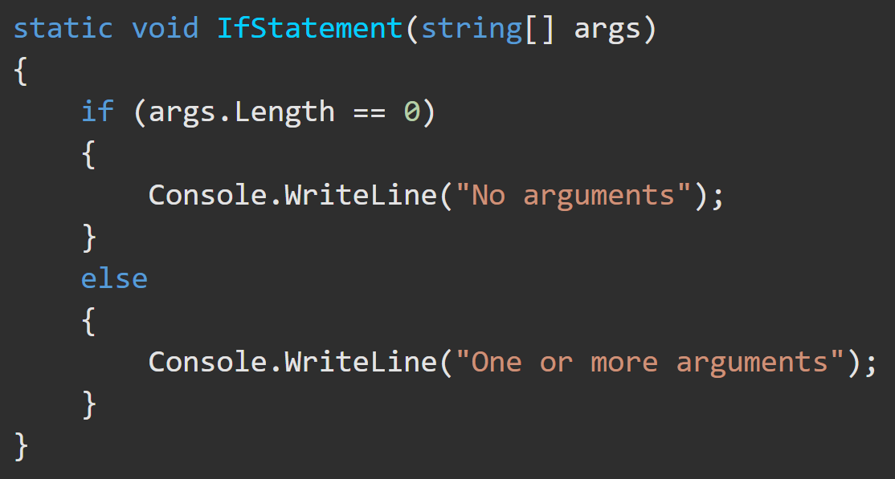
Selection Statements https://docs.microsoft.com/en-us/dotnet/csharp/tour-of-csharp/statements
Selection statements are used to select one of a number of possible statements for execution based on the value of some expression. This group contains the if and switch statements.

Slide 17
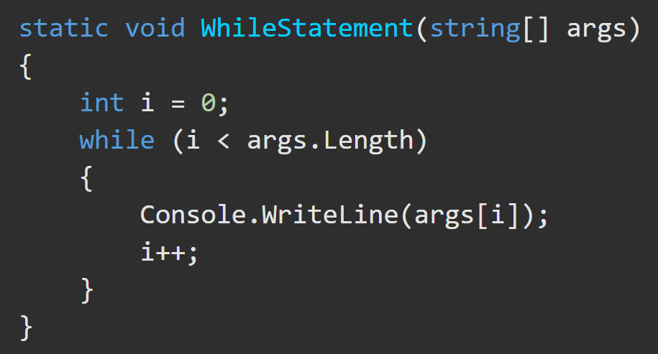
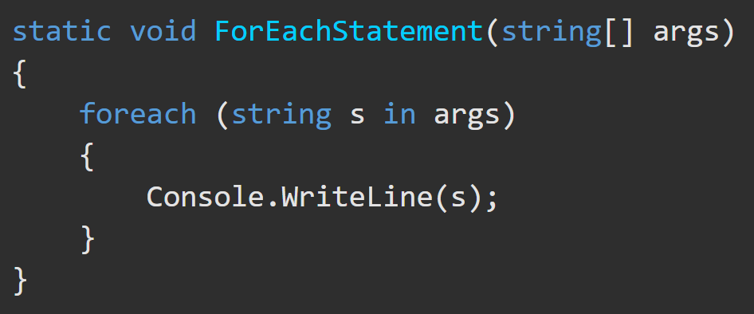
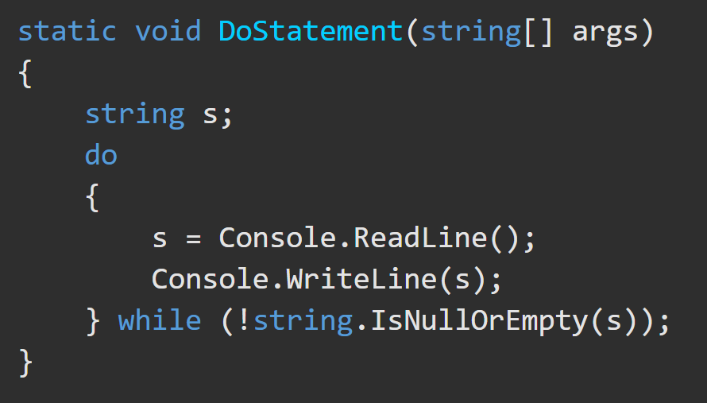
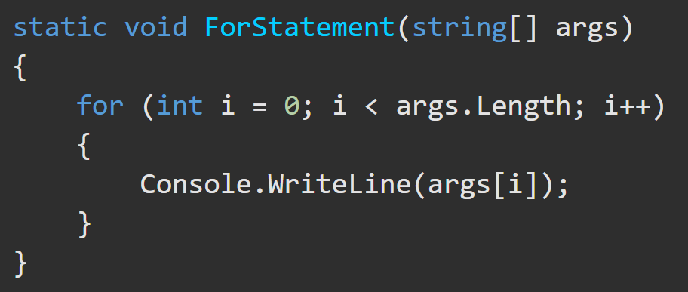
Iteration Statements https://docs.microsoft.com/en-us/dotnet/csharp/tour-of-csharp/statements
Iteration statements are used to execute repeatedly an embedded statement. This group contains the while, do, for, and foreach statements.

Slide 18
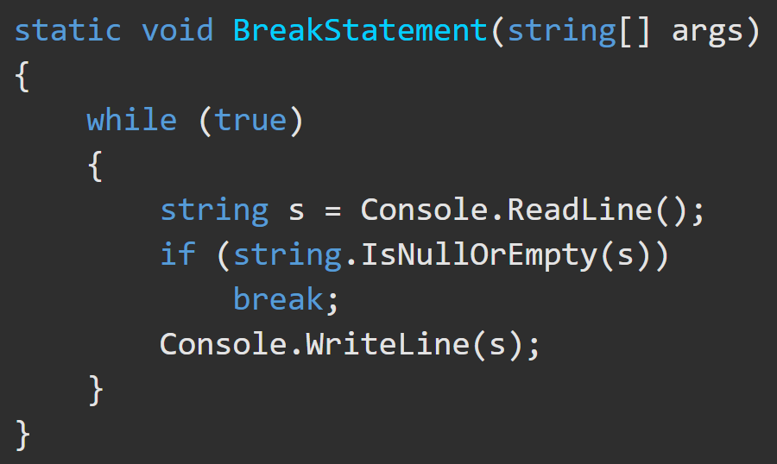
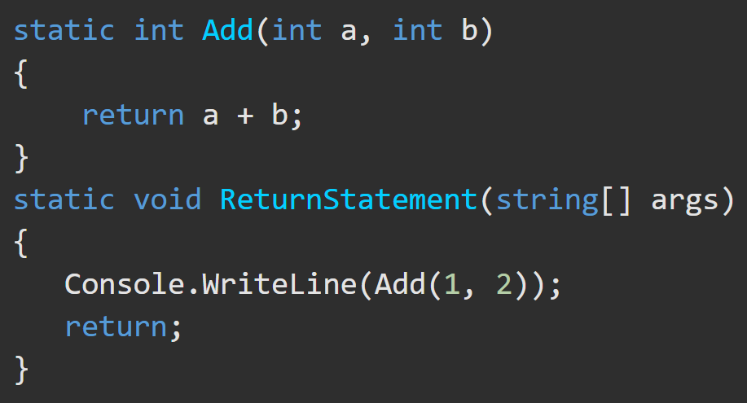
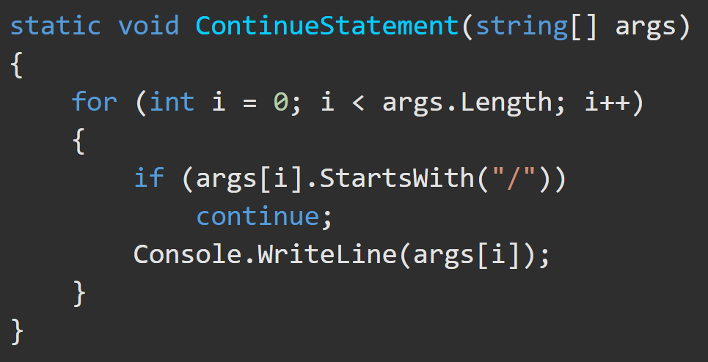
Jump Statements https://docs.microsoft.com/en-us/dotnet/csharp/tour-of-csharp/statements
Jump statements are used to transfer control. This group contains the break, continue, goto, throw, return, and yield statements.

